Slide 1


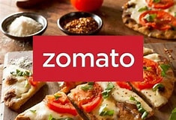
ZOMATO SALES ANALYSIS
NAME: MR.VIKASH SHARMA

Slide 2
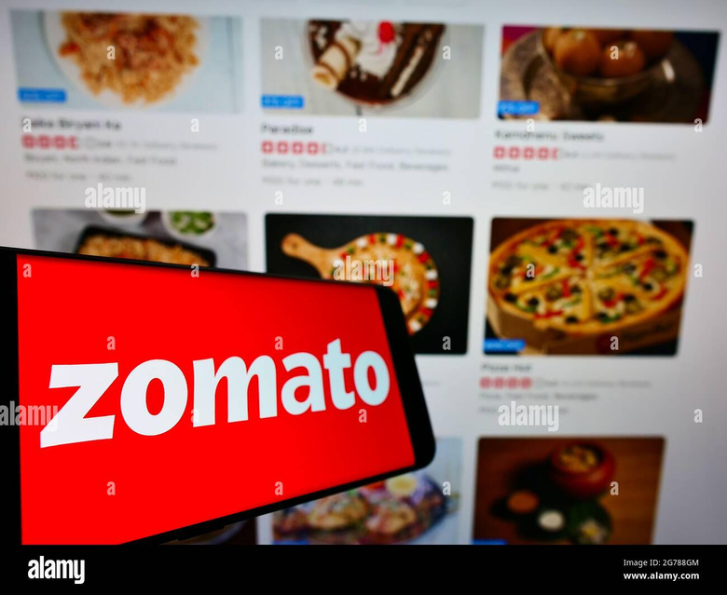
ABOUT ZOMATO
Zomato was started in 2008 by two friends, Deepinder Goyal and Pankaj Chaddah. They just wanted to make it more easy for people to find good food around them.
It started as just a website for restaurant listing, but now it became one of the biggest food delivery platform in India.
The company is based in Gurugram, and helps millions of people to order food, read reviews and also book tables in restaurants.
Using Zomato app or website, users can search restaurants by ratings, location, or type of food. It makes decision more easier.
Zomato was available in many countries earlier, but now it focusing mainly on Indian market.
They make money through delivery commissions, ads from restaurants and from memberships like Zomato Pro.
In 2021, it become one of the first Indian tech startup to go public by launching IPO.
Zomato is also doing steps toward environment, like less plastic use and eco-friendly delivery.
Recently, it also buyed Blinkit to start fast grocery delivery service.

Slide 3
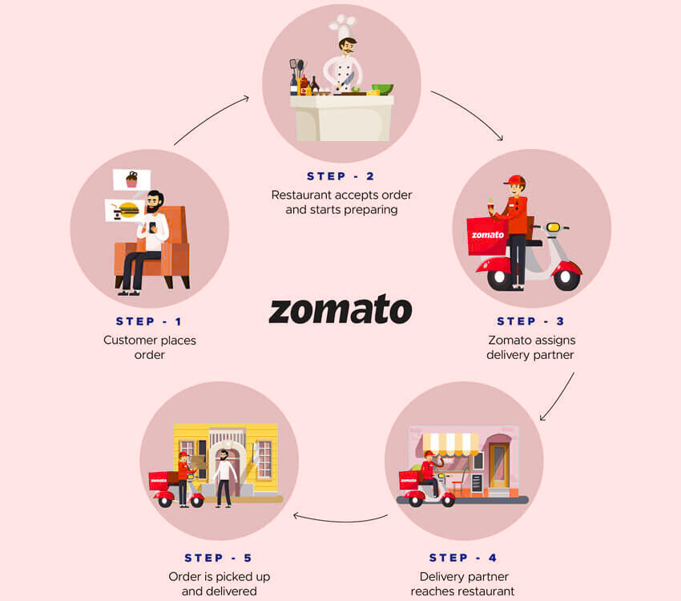
HOW ZOMATO WORK

Slide 4

ZOMATO DATASET
Key Info:-
Covers ~9,500 restaurants across countries like India, Australia, Brazil.
Includes details: Name, City, Cuisine, Rating, Cost, Online Delivery, etc.
Cleaning Steps:-
Merged country codes with names.
Fixed typos (e.g., “Indonesia)”).
Removed duplicates & filled missing values.
Why It's Useful:-
Helps understand food trends, customer choices, and pricing.
Supports business decisions in the food delivery industry.

Slide 5

ANALYTICAL APPROACH & TOOLS
1. Data Cleaning:
Removed duplicate entries and missing values.
Corrected errors like extra characters in country names (e.g., “Indonesia)”).
Standardized formats for cost, rating, and date fields.
2. Data Enrichment:
Merged restaurant data with country names using VLOOKUP (matching CountryCode).
Converted Datekey_Opening into readable date format.
3. Analysis Performed:
Trend Analysis: Found popular cuisines, top-rated cities, and price trends.
Statistical Summary: Average ratings, cost for two, vote counts.
Comparative Analysis: Checked how delivery or booking options affect ratings.
4. Tools & Features Used:
Excel features like Pivot Tables, Filters, Charts for insights.
Used basic formulas (SUM, AVERAGE) and conditional formatting for highlights.

Slide 6
: METHODOLOGY
CONTENT:
TOOLS USED: EXCEL, PIVOT TABLES, CONDITIONAL AGGREGATORS, CHART.JS FOR VISUALIZATIONS.
STEPS:
CLEANED DATA (REMOVED NULLS, STANDARDIZED FORMATS).
AGGREGATED BY COUNTRY, DELIVERY STATUS, AND PRICE RANGE USING PIVOT TABLES.
ANALYZED TRENDS WITH COUNTIFS, MINIFS, AND FILTERS.
CREATED VISUALIZATIONS FOR INVESTOR-FRIENDLY INSIGHTS.
OUTPUT: DASHBOARDS AND CHARTS TO SUPPORT STRATEGIC DECISIONS

Slide 7
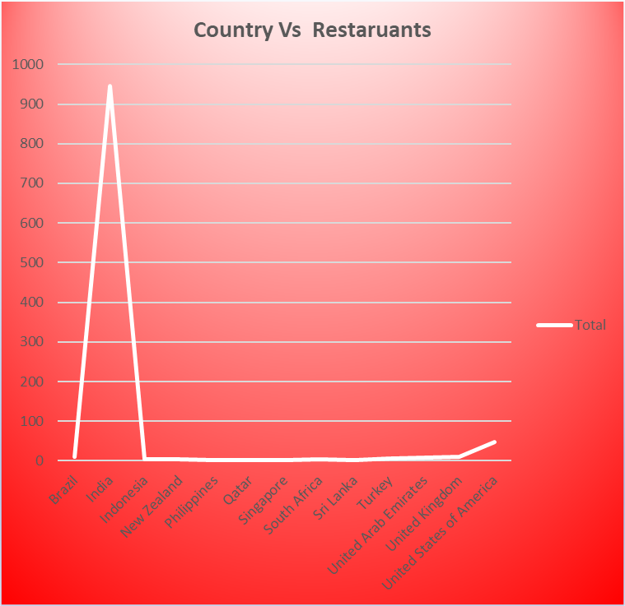
: Country-Wise Restaurant Distribution
Content:
Insight: India dominates with 90.5% of restaurants, followed by Brazil (6.2%) and others (3.3%).
Takeaway: Zomato’s market is heavily India-centric, signaling untapped global potential.

Slide 8
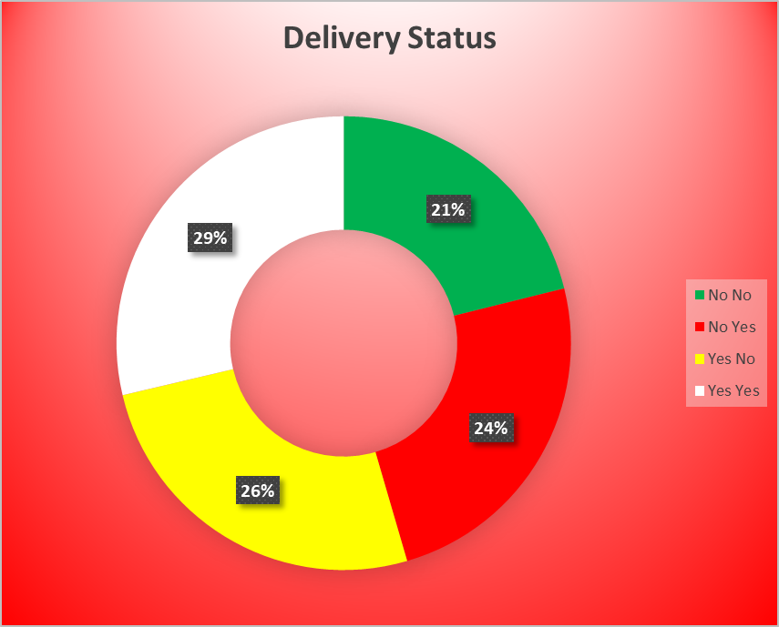
: Online Delivery Penetration
Content:
Insight: Only a small percentage of restaurants offer online delivery.
Takeaway: Significant opportunity to onboard restaurants for delivery, driving revenue.

Slide 9
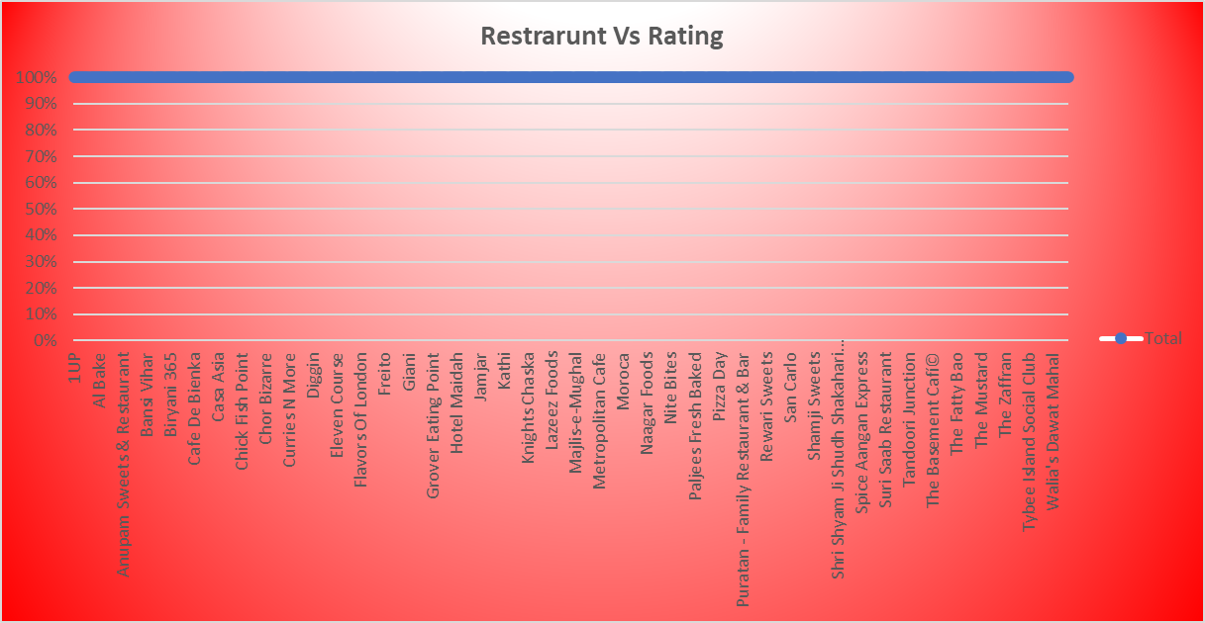
: Rating Distribution
Content:
Insight: Ratings cluster around 1.0 and 3.0, indicating inconsistent quality.
Takeaway: Quality control measures can enhance customer trust.

Slide 10
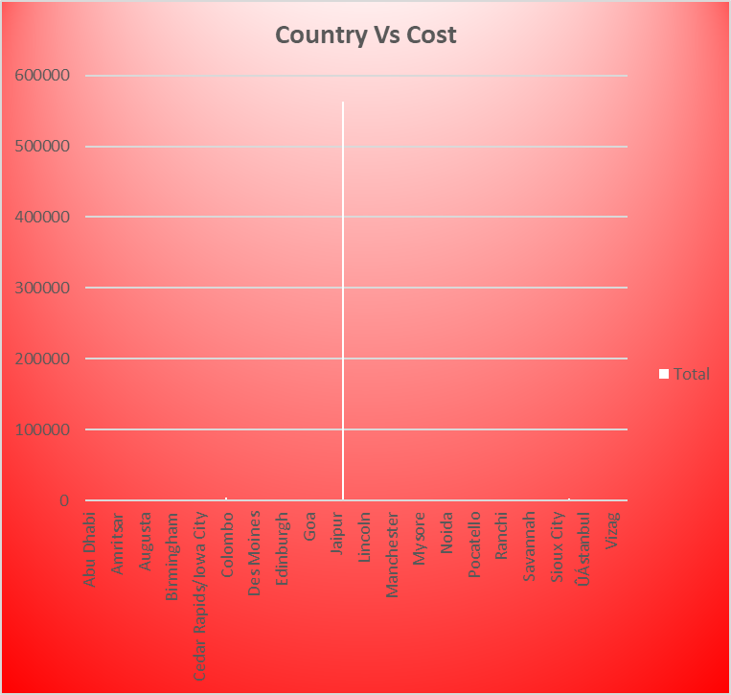
: Market Expansion Opportunities
Content:
Insight: Emerging markets (e.g., Jakarta, São Paulo) have low restaurant presence.
Rationale: Low competition and growing urban demand make these markets attractive.
Recommendation: Partner with local chains to accelerate growth.

Slide 11
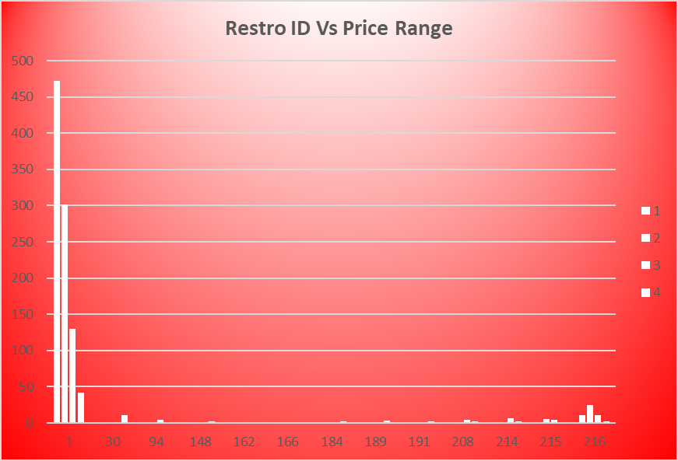
: Pricing Strategy Insights
Content:
Insight: Most restaurants are in the low-cost bracket (₹100–₹400 for two).
Rationale: Affordable pricing drives volume but limits margins in urban areas.
Recommendation: Introduce premium offerings in Tier-1 cities.

Slide 12
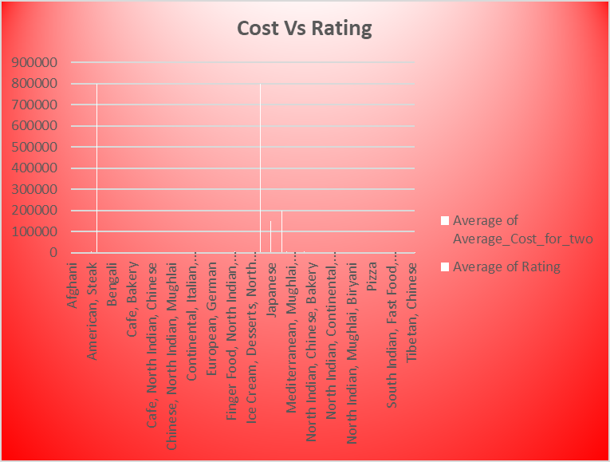
: Consumer Behavior Trends
Content:
Insight: Ratings and votes misalign, suggesting inconsistent engagement.
Rationale: Customers may not trust low-rated restaurants, impacting retention.
Recommendation: Launch loyalty programs and targeted campaigns.

Slide 13
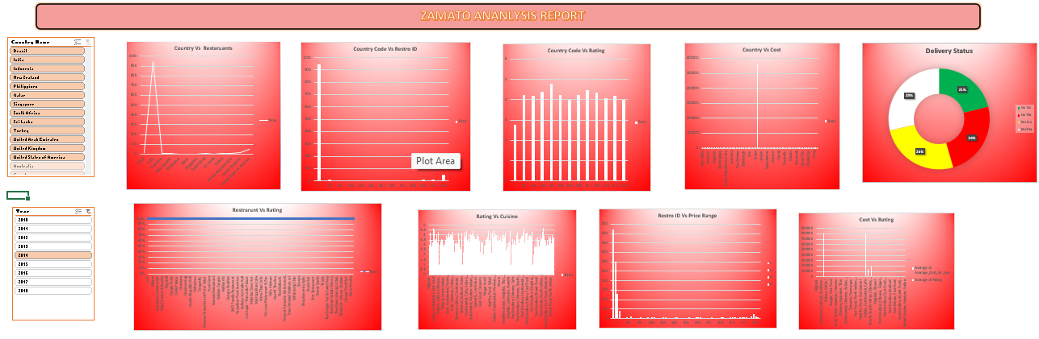
Dashboard Overview:

Slide 14
Conclusion
The Zomato sales analysis highlights robust performance and clear avenues for future growth. By focusing on strategic expansion, partnerships, and continuous app improvement, Zomato can further solidify its market position and enhance user satisfaction.

Slide 15
References
Canva Cookie Policy: https://www.canva.com/policies/cookies-policy/
Presentation Design Source: https://www.canva.com/design/DAGttHHwTd4/tzrRyJuoMzJgMMDf9YMMwA/edit#
Internal Zomato Sales Data (Mr. Vikash Sharma's analysis)
For further details, please refer to the provided links and internal documentation.

